Slide 1
Property Prices and Interest Rates Analysis in Australia
Duc, Pragya, Itzchak
Notes:
Good evening everyone
Welcome to the presentation of our project on ______
Our team members are Pragya, Itzchak and myself.
In this presentation,
I will go through the executive summary and findings,
Itzsack will then go through the Data Techniques; and
Pragya will go through the demonstration of our code.

Slide 2
Executive Summary

Slide 3
Motivation & Summary
Aim: Evaluate the performance of Australian residential properties and investigate its relationship with interest rate.
Motivation:
residential property is a popular investment choice
conduct our own analysis from empirical data
investigate the relationship between property prices and interest rate
predict the performance of Australian property prices in the near future
Notes:
residential properties
is a popular investment choice among other asset classes in Australia
have performed well over the past few decades
viewed favourably by investors as one of the most consistent real estate markets worldwide.
Our aim for this project is:
To evaluate the performance of Australian residential properties from empirical data
To investigate the relationship between property prices and interest rate (one of a popular macro economic indicator)

Slide 4
Motivation & Summary
Aim: Evaluate the performance of Australian residential properties and investigate its relationship with interest rate.
Hypothesis:
Australian residential property price has increased over the past years.
There is an inverse relationship between property price and interest rate.

Slide 5
Questions
How did Australian residential property perform?
Is there a relationship between interest rate and Australian residential property price?
How will Australian residential property price behave in the future?
Notes:
How did residential property perform?
the current residential property prices
change over time between different cities/states
If you invested 100K in property in 2011, how much you will have now
Is there a relationship between interest rate and residential property prices
How will residential property prices behave in the future?

Slide 6
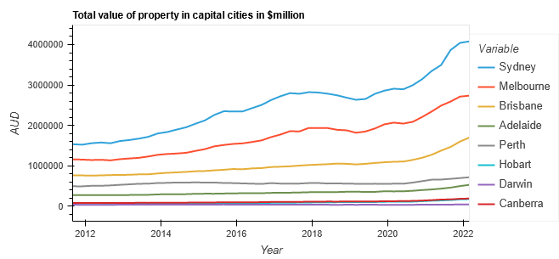
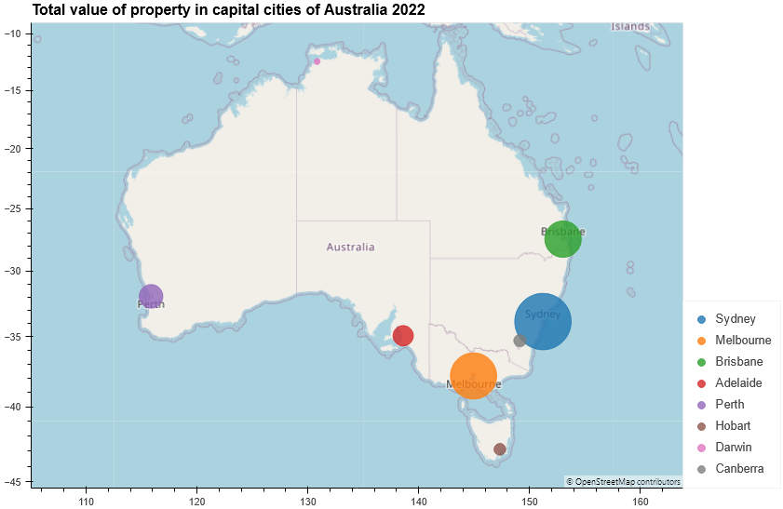
Australian residential property performance (1)
Notes:
This is our findings:
[insert map plot + bar chart]
In term of performance:
The 2 graphs showing the total value of all residential dwellings for 8 states and territories.
The state with highest value is NSW
The state with lowest value is NT

Slide 7
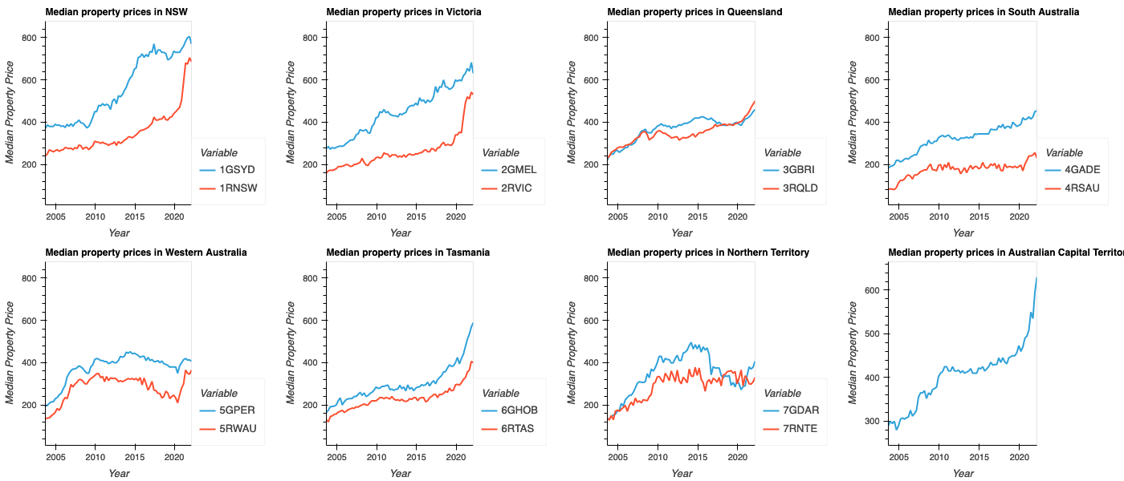
Australian residential property performance (2)
Notes:
[insert median charts of Aus and all states ]
The charts above represent the median house (established, attached) prices in Australian capital cities and regional areas.
The median house price is the sale price of the middle home in a list of properties ranked from highest sale price to lowest over a quarter.
We chose median house prices instead of the average (or mean) because a few unusually high or lower prices can skew the average price and
therefore won’t be an accurate indication of the current state of the property market.
There is aN obvious upward trend of the median house prices across all states and territories.
We note that there is a sharp increase in 2020-2021 across Australian cities, at the height of COVID.
Especially in Regional NSW, Regional VIC, and the ACT

Slide 8
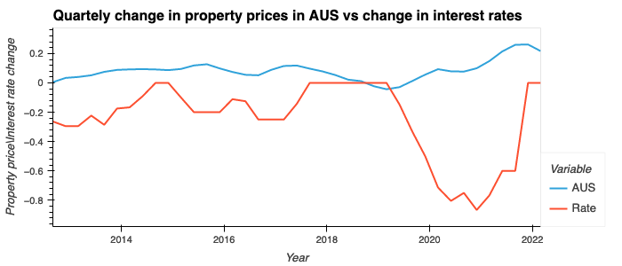
Relationship with interest rate
Notes:
Next, we wanted to explore the factors that affect the property price.
We chose RBA’s interest rate because it is a popular macro-economic indicator and is widely published.
Theoretically, we would expect an inverse relationship between Australian property prices and interest rate.
As you can see on the chart, as the IR went down, the house price went up, especially in 2020-2021.

Slide 9
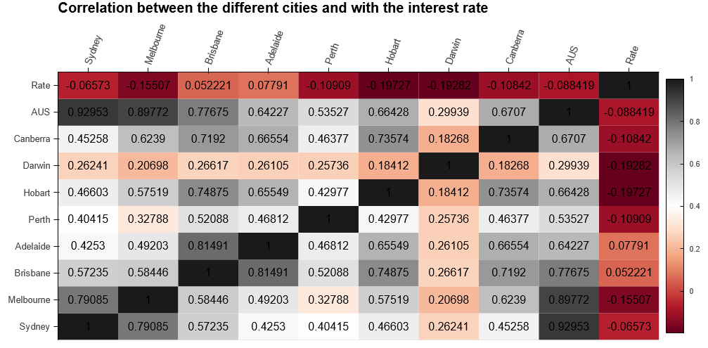
Relationship with interest rate
Notes:
[insert line chart + insert correlation matrix]
Using the correlation function, we find that there is generally a negative correlation between interest rate and house prices in most states.
The most negative correlations are with Hobart and Darwin

Slide 10
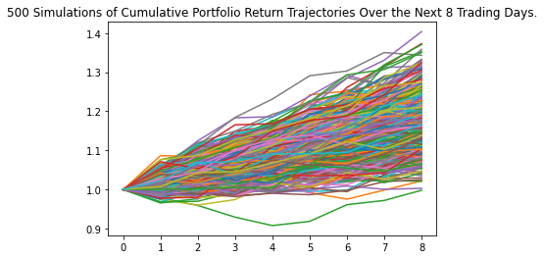
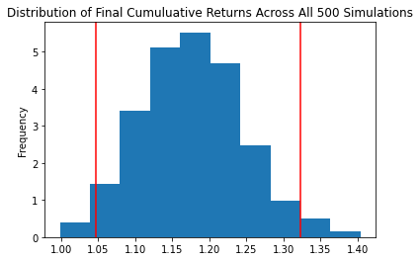
Prediction
Notes:
We then used Monte Carlo simulation to predict the Australian house price in the next 8 Quarters (or 2 years)
The conclusion is that there is a 95% chance that an initial investment of $1,000,000 in the australian realestate over the next 2 years will end within in the range of $1.05 and $1.32 millions

Slide 11
Findings summary
Australian residential property performed well over the last decade.
There is an inverse relationship between interest rate and Australian residential property price.
Australian residential property is likely to perform well in the next 2 years.

Slide 12
Data Techniques

Slide 13
Data Techniques - Data sources selection:
We relied on ABS data for property data and we downloaded the interest rates from the RBA website
Residential property prices - We used the ABS API (using the RES_DWELL data flow). The data shows Quarterly median residential house prices across the 8 major cities
Interest rates - Data was downloaded as CSV from the RBA website (no API available). We used the monthly average
We also added in code the locations of the 8 cities (longitude and latitude). We found this data on the internet
We tried to look for other data sources but they all required payment (Core Logic, Domain, REA)

Slide 14
Data Techniques - Data Preparation
Initially we had to fit the residential property data structure to match the same structure as the interest rate data. It involved pivoting the the dates from columns to rows
Next, we had to align on the data resolution, interest rates were monthly while the residential property data is quarterly. We decided to leave the relevant months and delete all the others
Once we had the two data frames in the same format we concatenated the data into one data frame
Lastly, for some analysis like correlation, we had to convert the median prices and interest rates to % changes

Slide 15
Approach - Technologies Used
To retrieve the ABS data we used a library called pandassdmx. It’s a library used to handle the SDMX format which is a standard used by many data providers
We Heavily relied on Pandas for our data analysis. We loaded the data from a CSV to pandas dataframe and prepared the data using pandas functions
For the visualisations we used the Mathplotlib library , Holoviews and the HVplot library
For the Monte Carlo simulation we used the helper class that we used in class

Slide 16
Approach - Breakdown of Tasks and Roles
We had a mix of tasks, all of us touched the code and we used branches to merge our changes.
We divided the preparation and analysis to separate notebooks, it helped with less code conflicts
Also for the presentation we divided the content and assigned an owner for each slide
This was the focus of each one of us during the development
Pragya - Data visualisations
Duc - Data preparation and loading
Itzik - Code structuring and cleanup
For the presentation we divided the content as follow:
Duc - Executive summary, research questions, and results
Itzik - Data techniques, approach and next steps
Pragya - Demo

Slide 17
Approach - Challenges
The main challenges were about the available data:
Initially we wanted to compare residential prices vs other sectors but we couldn’t find any data on these other sectors
The resolution of the data that we found for residential property prices was only quarterly and as a result we only had about 60 data points which makes the analysis less reliable. If we had more data points we could use ML forecasting techniques to estimate future prices
Another challenge we had was about the API data format. When we tried using the JSON parsing techniques learned in class it failed because the format was not a standard json but SDMX format.
Lastly we had a minor challenge on which interest rate data we should use. Most of the data sources are showing a daily/monthly level or just the days when it changed. This data wasn’t matching with the other data we had

Slide 18
Approach - Successes
We answered questions that compared prices and trends in Australia
We were able to find correlations between different cities and interest rates
We forecast the future prices and came to the inevitable conclusion that property prices in Australia can only go up :-)
And most importantly, we enjoyed working with each other and achieve so much in such a short time!

Slide 19
Demo

Slide 20
Next Steps -
If we had more time we would contact REA, Domain and Core Logic to access their APIs and get richer data:
We would explore other sectors and see how they compare to the residential data
We would refine the analysis with more data points
And we would
A forecast of how interest rate changes can influence the prices in different regions and sectors
Compare the Aussie market with other markets like the US or NZ

Slide 21
Links
GitHub repo: https://github.com/feldmanp/project_1_2
Pandassdmx library - https://pandasdmx.readthedocs.io/en/v1.0/
ABS API documentation - https://www.abs.gov.au/about/data-services/application-programming-interfaces-apis/data-api-user-guide
https://www.rba.gov.au/statistics/historical-data.html

